Slide 1
Topology Data Analysis for Time Series
Notes:
1.Previous study :Topological analysis for time series
2. Concepts to help understand the paper
3. Focus on the Takens Embedding & PH, which will be used to project the time series into a higher dimensional space but still preserve the topology of the original space.
4. Extend the usage with treasury yields& compare to MST

Slide 2
Previous Studies and Today’s Focus
Topology and Financial Data
  Non-TDA related methods
    Example 1: Brisbois F. Vandewalle N. researched the topology of stock markets in 2000s’.
    Example 2: Phoa W. studied the geometry of co-movement in a set of stocks.
  2. TDA on financial Data
  Gidea’s study in 2008 Financial Crisis: Use TDA to detect early signs for critical transition in financial data.
Today’s Focus
  Apply Takens embedding and Persistent Homology to detect transitions in time series financial data set
Notes:
Vandewalle: used cross-correlation of daily fluctuations for all US stocks during 1999 and looked at the topology exhibited by the minimal spanning tree
Phoa: collected monthly index return for index constituents of the S&P 100 and S&P 500. and built a high-dimensional correlation matrix, and then use the diffusion maps to project the correlation matrix to a 3D hyperplane. The closer two assets represents higher correlation. This approach is quite robust to the noise. Also, it has some limitations, the coordinates didn’t have an intuitive economic meaning.
Gidea: built time-depend correlation networks for multiple stocks from late 90s to 2009, Then the author used the sliding window and extracted the point cloud datasets to associate a topological space. Then by comparing the persistence landscapes to capture the regime shift. Then, he found the Persistence landscapes show big change prior to financial crashes.
Today’s focus: (find recurrences of a time series using time-delay embedding on sliding windows in combination with PH)

Slide 3

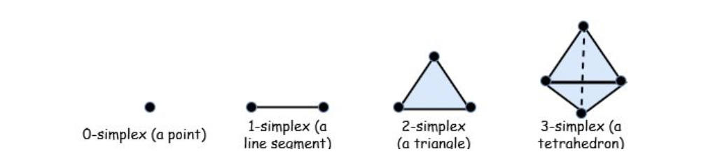
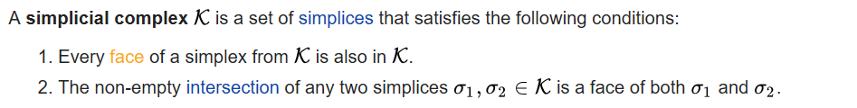
Concepts
Homology
  The homology of a topological space X is a set of topological invariants of X represented by its homology groups where the k-th homology group represents the k-dimensional holes in X.
2. Simplicial Complexes
Notes:
Homology of a topological space can be represented by its homology groups, for example holes , void
Simplicial complex: (rep complex)First we created simplex by connecting nearby points in the cloud if the distance between each two points is greater than parameter ϵ
Then Simplicial complex has been created by connecting simplices. The connections also follow two rules.

Slide 4
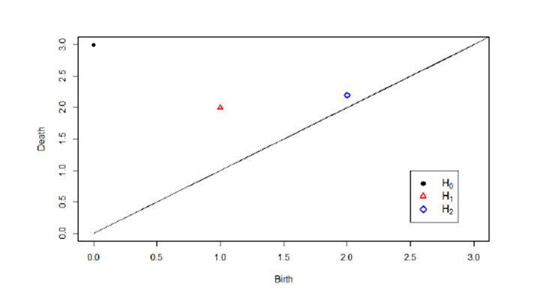
Concepts
Persistent Homology
PH is to find the homological features of a topological space (specifically simplicial complex) that persist which you vary ϵ
Persistence Diagram
Maximum Persistence
Persistence Landscape
Notes:
3. PH describes that features/ or the simplices continuously exist when we adjust/increase the parameter ϵ
4. We try to describe the PH in a finite two dimensional diagram. One axis represents the birth of the i-th feature, and another dimension represent the death. The most persistent feature is the one far away from the diagonal in the diagram.
5. Maximum persistence is the largest distance from the point to the diagonal for each dimension homology.
Di is the persistence Diagram for i-th homology (for dimension homology, there might exist multiple points in the diagram)
6. Rotates the persistence diagram so that the diagonal becomes the new x-axis (it’s easier to see the distance from point to the diagonal)

Slide 5
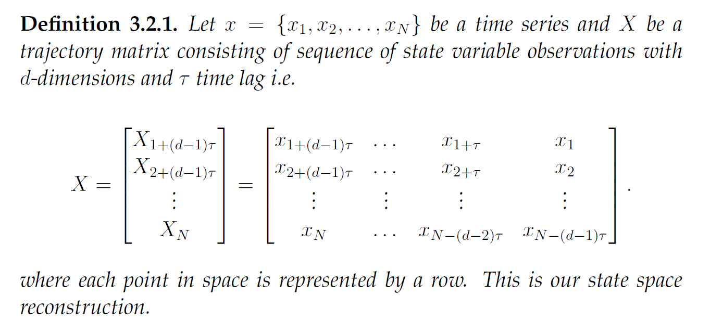
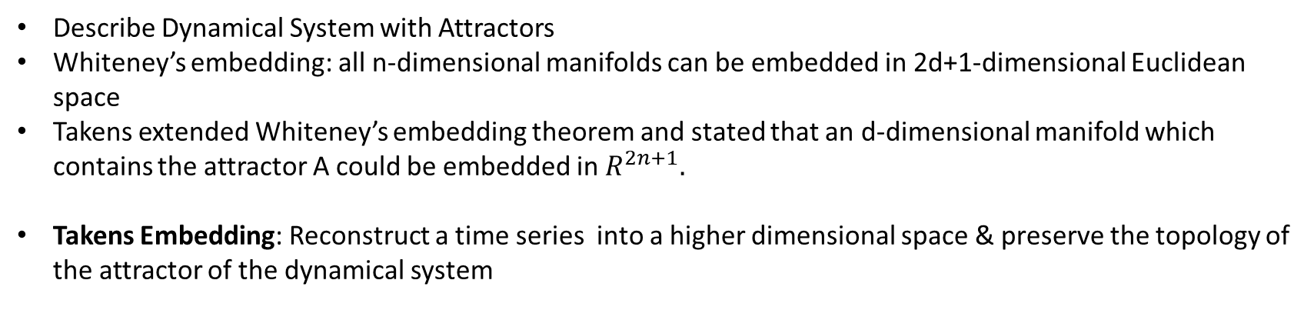
Concept: Takens delay coordinate embedding
Describe Dynamical System with Attractors
Whiteney’s embedding: all n-dimensional manifolds can be embedded in 2d+1-dimensional Euclidean space
Takens extended Whiteney’s embedding theorem and stated that an d-dimensional manifold which contains the attractor A could be embedded in $R^{2n+1}.$
Takens Embedding: Reconstruct a time series into a higher dimensional space & preserve the topology of the attractor of the dynamical system
Notes:
Most of time, we use the states which vary over time to describe or model a dynamical system. The evolution of the system is a trajectory through the space of the states. Here we define Attractors are those points in the space that the trajectory is drawn towards.
If we can find the pattern of the attractors, that means we can define this dynamical system in a certain way
Two theorems
Takens explanation
Defination 3.2.1 one-dimensional data
Takens embedding assumes that the time series data is not contaminated by noise
b.C such noise get amplified according to the largest Lyapunov exponent in the process and can affect te reconstructed attractor

Slide 6
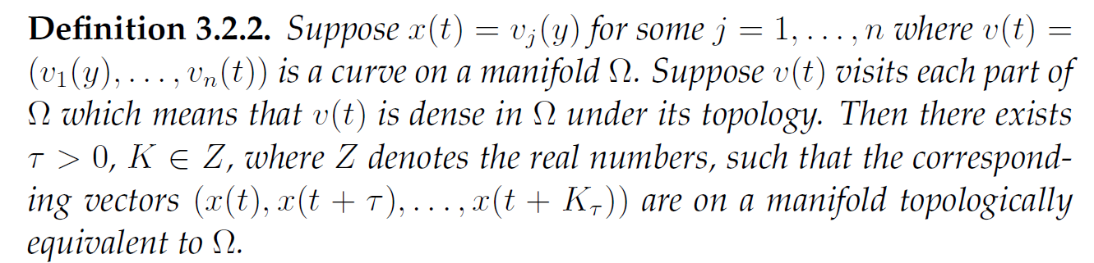
Concept: Takens delay coordinate embedding
An attractor is then the pattern created by the points X in space.
Parameters choices for a good quality attractor reconstruction
Determination of dimension (d)
  d> 2*d0 , where d0 is the box-counting dimension of the attractor of the underlying system
  False nearest neighbors
Determination of time-delay (currently no general way so far)
  Should be large enough so that info from the value of x at time t+ τ is significantly different from the info from x at time t
  Should not be large enough so that the system loses memory of its initial state
Notes:
We want to make sure the new space created by X presever the topological of the attractor in the original system.
V(t) attractors
False neighbor: distant points in the original space are close in the reconstructed space. These points are called false neighbors. If the dimension of reconstructed space is high enough, the ration of false neighbor should be close to 0
* State the advantage:Takens embedding assumes that the time series data is not contaminated by noise
b.C such noise get amplified according to the largest Lyapunov exponent in the process and can affect the reconstructed attractor
Limiation: still need to reduce the dimension

Slide 7
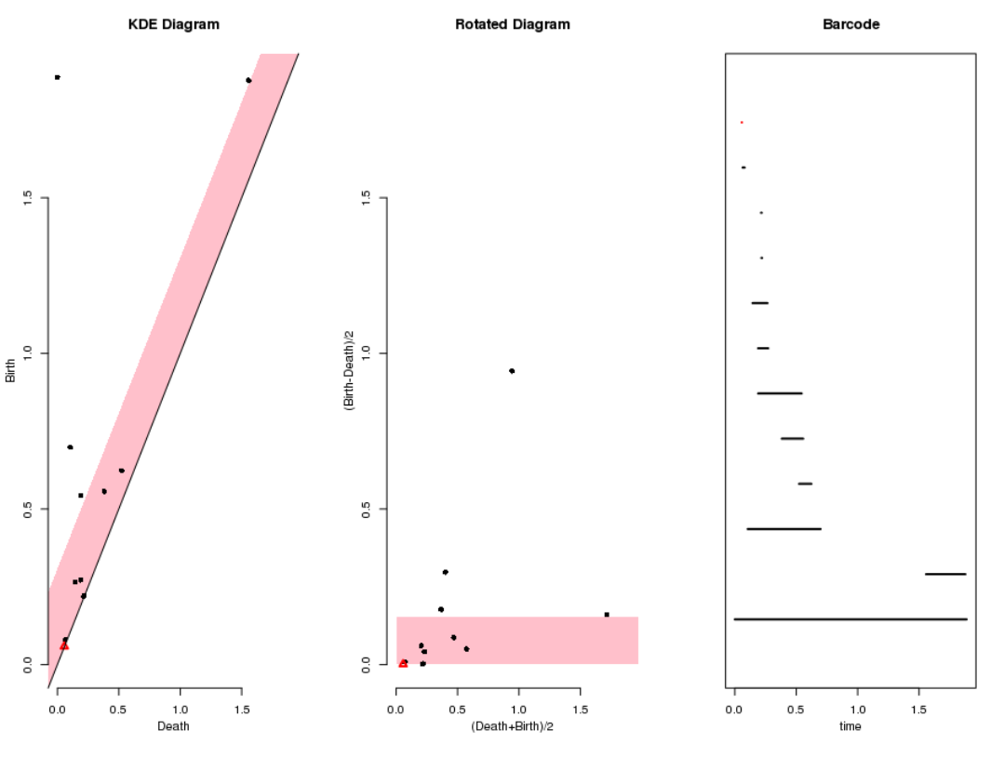
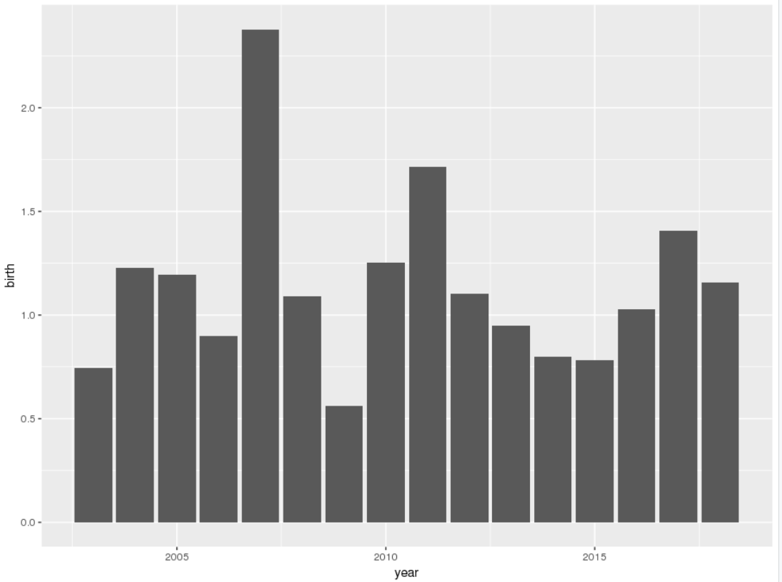
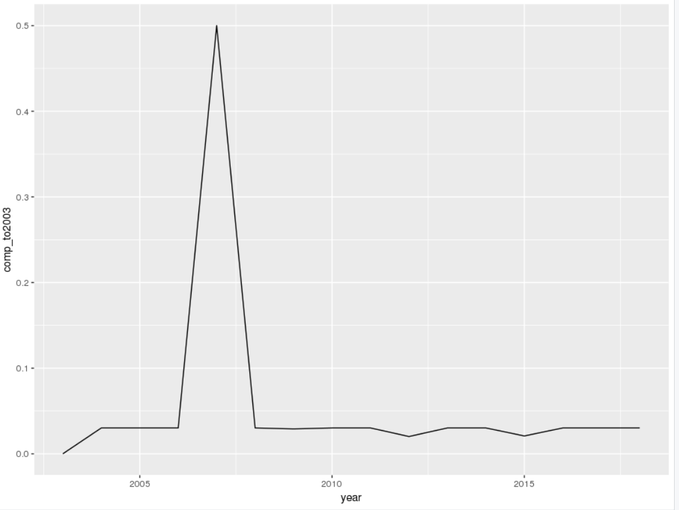
Examples with DGS data
1. DGS1 and DGS3
Notes:
Data description:2003 to 2018
Data manipulation
Explaination
How to set upTDA in r?

Slide 8
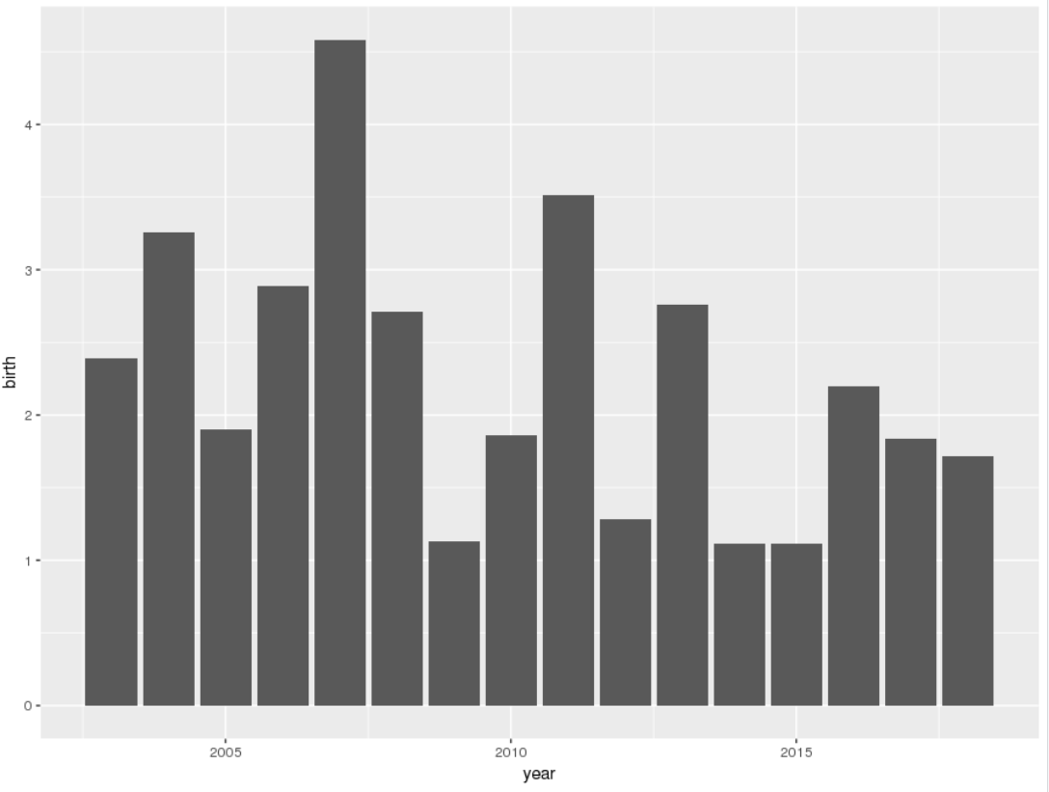
Examples with DGS data
2. DGS1, DGS3 and DGS10

Slide 9
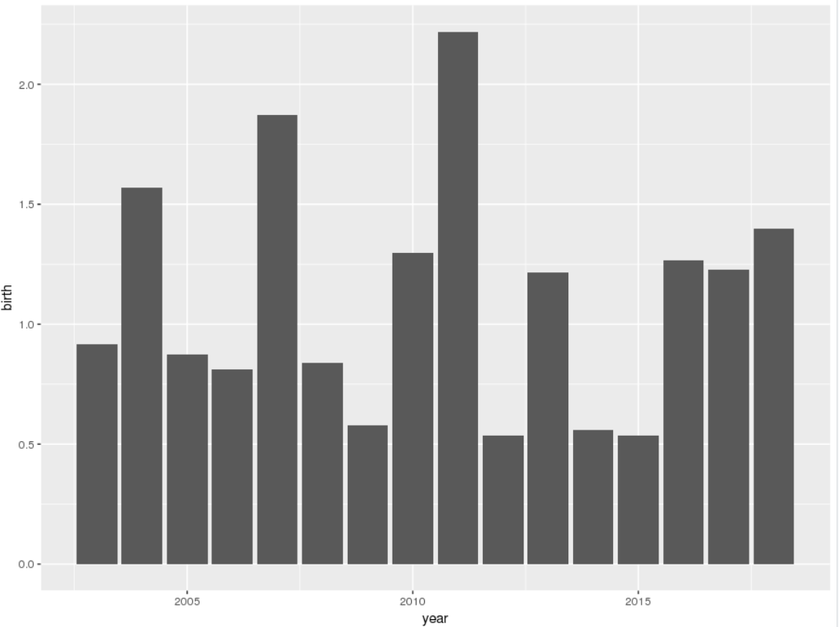
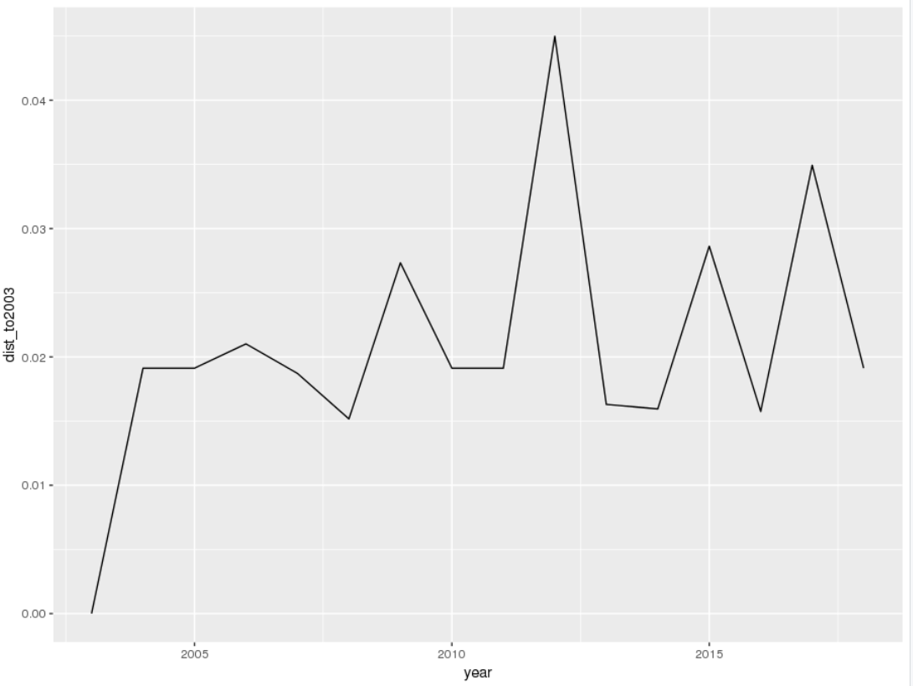
Examples with DGS data
3. DGS1 and DGS1_3monthLag (Embedding)
Notes:
Explaination
Why not higher dimension

Slide 10
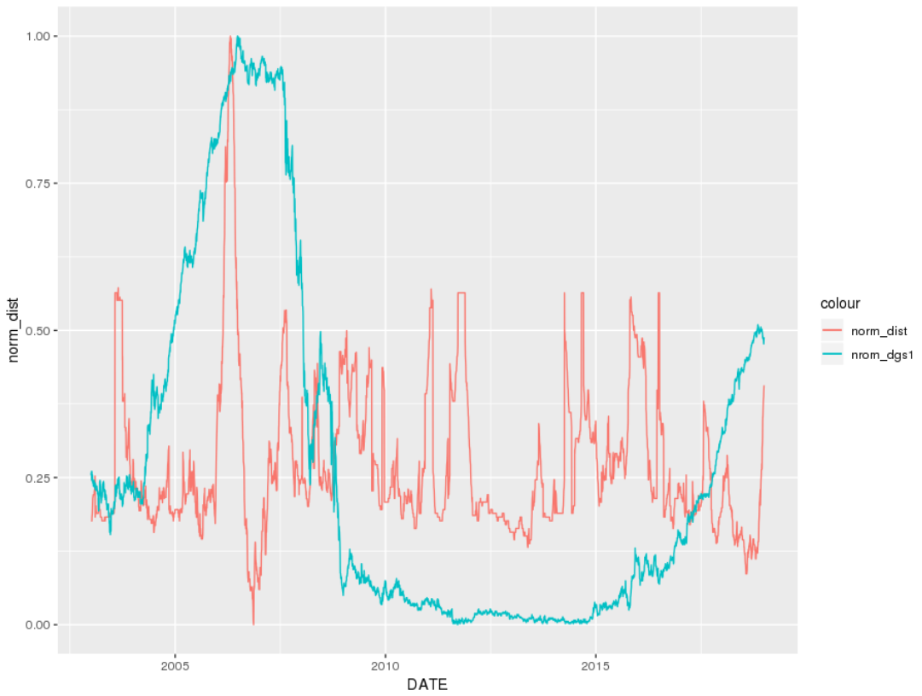
Another Topological Approach: MST

Slide 11
Concept: Taken embedding
1.Dynamic System (state space & attractors)
2.N-dimensional manifold: smooth map to a Euclidean space
3.Taken embedding： based on Whiteney’s embedding theorem
Def 3.2.1 in page 19
prove the new matrix topological to the one-dimensional time series ( look at definition 3.2.2)
Why taken?
not contaminated by noise~ (!!!)
Taken’s challenges: pick the embedding dimension, m and time delay ,tau
One improvement: financial time series are quite jittery, might affect Taken’s state space reconstruction. Smoothing might remove jitters and make Taken’s state space reconstruction more efficient.
Last step, construct point cloud sets with sliding windows.
Notes:
Limitation to Taken’s embedding : should be coupled

